Slide 1

Genomic data classification
Presented by : Roei Michael and Bar Daabul

Slide 2

Motivation
We are doing a research project in order to enable life-saving real time classification and diagnostics of pathogens.
The genomic data has an impact on various fields such as medicine, genetics, and biotechnology. In the field of medicine, the identification of pathogens is very important to make life-saving decisions.
There are some challenges in analyzing and classifying genomic data. The dataset has a large size, the patterns are very complex, and accurate predictions are necessary.
The pathogen detection is a time critical problem of large scale, and the existing methods of classification are very slow.
In this project we develop a real-time pathogen classifier neural network using CNN.

Slide 3
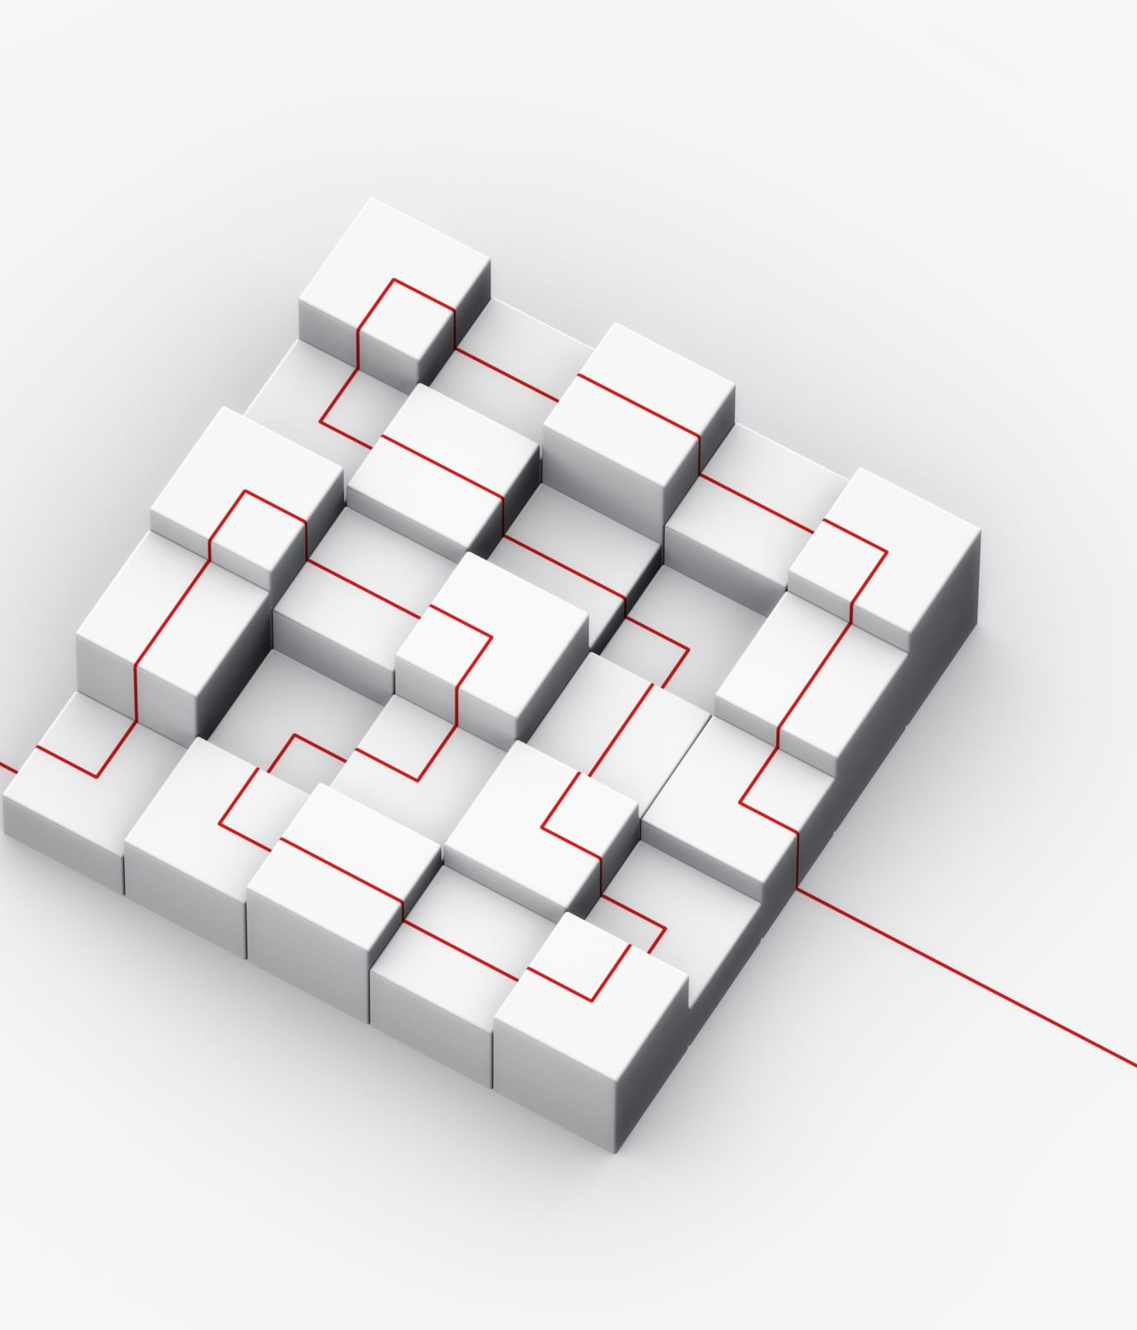
The network model
The proposed network model is a pathogen classifier using convolutional neural networks (CNN). It is designed for the classification of genomic data, specifically one-dimensional genomic sequences.
We started by trying a simple model with only a few fully connected layers. We improved the model by adding a layer of convolution followed by an activation function (Relu) and then a pooling layer. Finally, after testing around the different sizes of layers we made the final model.
The model consists of several layers including convolutional layers, activation functions, max pooling layers, and fully connected layers.
The model has four layers in each layer we go through: convolution, activation and pooling. The convolutional layers perform convolutions on the input data to extract relevant features. Each convolutional layer is followed by a ReLU activation function to introduce non-linearity. After each activation function, a max pooling layer is applied to reduce the spatial dimensions of the feature maps.
The output from the last convolutional layer is flattened. The flattened tensor is passed through two fully connected layers: fc1 and fc2.
The output from the last fully connected layer is the result (a tensor with dimension of the number of classes).
This model is more accurate and can classify pathogens well and efficiently.

Slide 4

Network Design and Training
We implemented the network using PyTorch- a popular deep learning framework.
Sklearn - library for analysis and other classification related functions.
pandas for formatting the data .
OS for a lot of file read and writing. (And some other libraries)
The genomic data is preprocessed before training the network.
The input sequences are encoded and transformed into a suitable format for the network.
The sequences are padded or truncated to a target length to prevent computation problems.
Label encoding is also performed to convert the categorical lineage labels into numerical binary form.
We used a train test split with 20% test and 80% training data.
The network is trained using a cross-entropy loss function, which is commonly used for multi-class classification problems. In addition, the Adam optimizer is employed to update the model parameters during training with a learning rate of 0.001.
The training is performed for a fixed number of epochs (30 in our case), with each epoch iterating over the entire training dataset in mini-batches. During each training iteration, the model parameters are updated based on the computed loss and backpropagation.

Slide 5
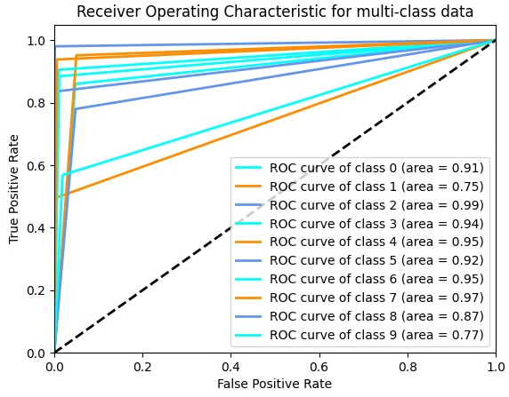
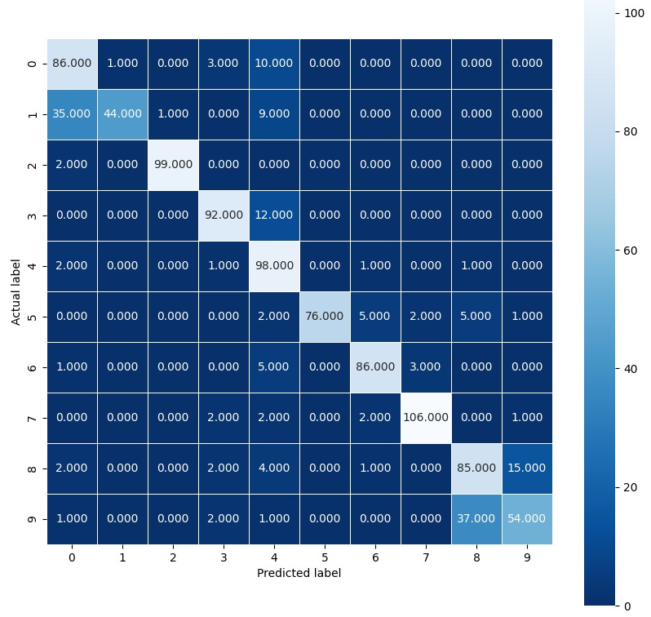
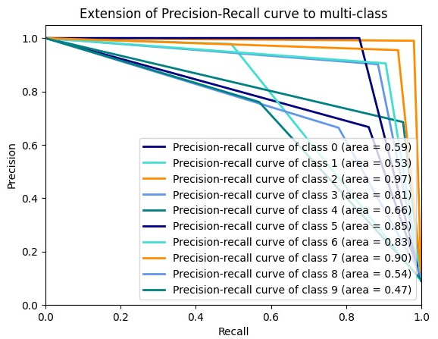
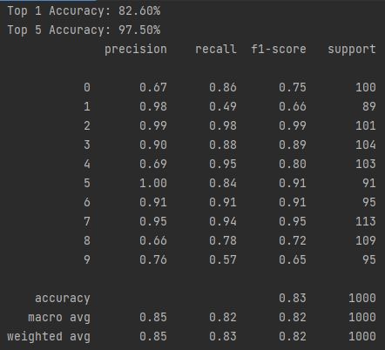
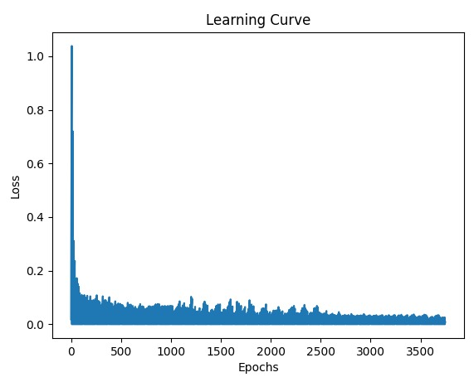
Results and Potential Future Work
We randomly selected 5,000 data files of pathogens belonging to 10 different classes as inputs.
After training our model on the training data set, we got to a pretty good accuracy on training and we saw that class precisions were starting to shape up a bit better than previous test models, we calculated test accuracy and got up to 83% acc for the model.
We printed a confusion matrix in the form of a heat map showing us what weak spots and what strong spots our model has,
We calculated the ROC and the precision-recall graphs to each class in the model to see if some classes are more problematic than other.
Lastly, we added a learning curve graph to show the number of iterations it took to reach saturation with the model.
In the continue, we will run the model on larger dataset with more classes and try to improve the dataset further in different ways (for example, by performing additional preprocessing operations).
In the future, we will try to integrate the algorithm with a hardware accelerator, and research the results and the performances.

